Slide 1
American Culture and Etiquette
Work of taras Nagornij, student group vt-23-1 of Zhytomyr polytechnic state

Slide 2

Age and Alcohol
It is illegal in the U.S. for individuals under 21 years old to consume alcohol. Supplying alcohol to those under 21 is a criminal offense

Slide 3

Classroom Etiquette
Active participation in class discussions is highly encouraged and can impact your grade. Attendance in class is mandatory

Slide 4
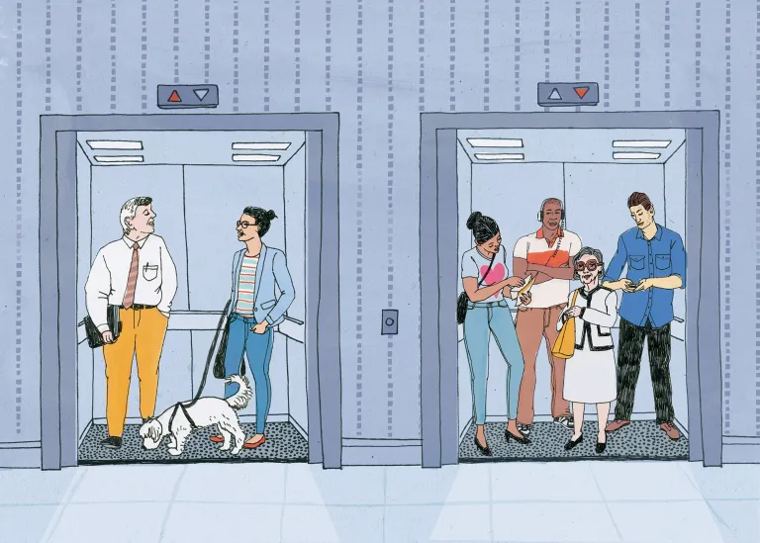
Interacting with Strangers
In the U.S., it is common to greet strangers on the street. Don’t hesitate to respond to greetings

Slide 5
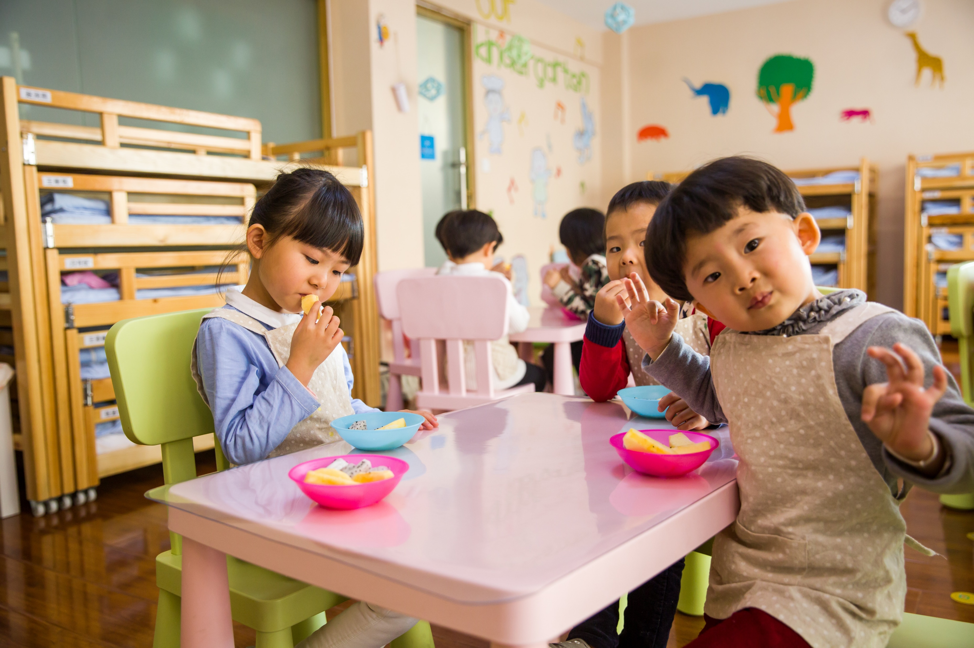
Classroom Behavior
Some instructors allow eating and chewing gum during class

Slide 6
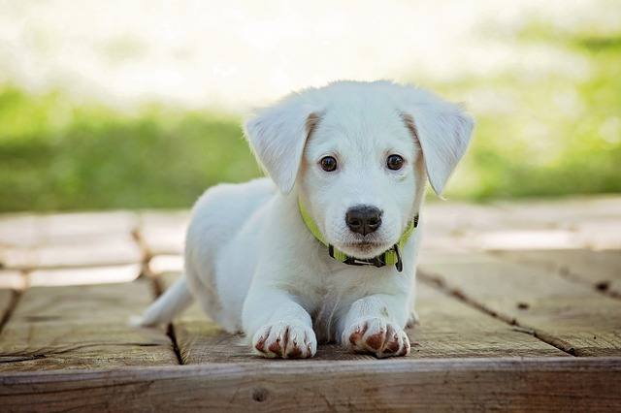
Pets and Animals
Americans love their pets. There are laws in the U.S. protecting animal rights. If you encounter a pet, be respectful and ask the owner before petting it

Slide 7
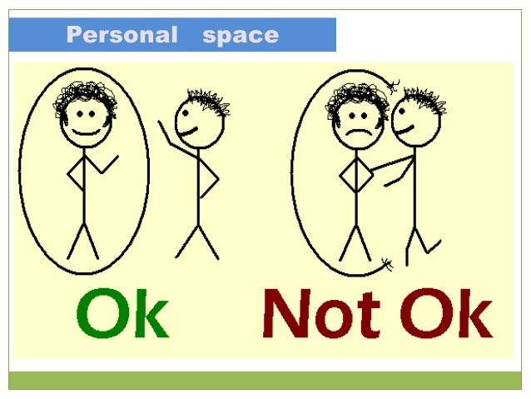
Personal Space
Americans value personal space. Maintain a comfortable distance when interacting with others

Slide 8
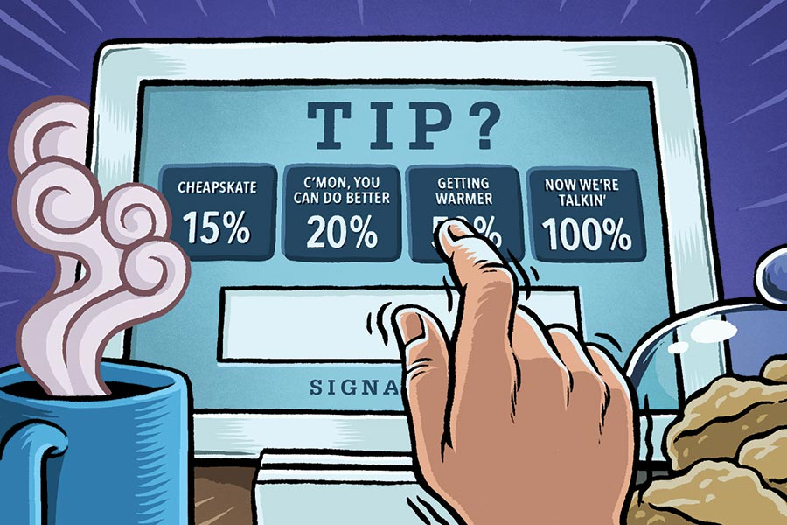
Tipping
Tipping is customary in the U.S. It is expected to tip servers, taxi drivers, and other service providers

Slide 9
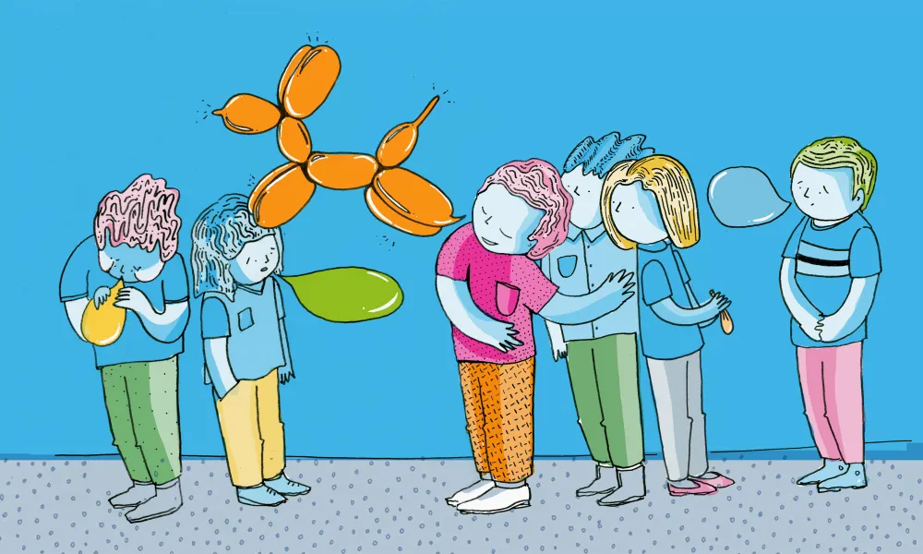
Small Talk
Engage in small talk to build rapport. Topics can include weather, hobbies, and current events

Slide 10

Punctuality
Being on time is essential. Arrive promptly for meetings, classes, and social gatherings

Slide 11
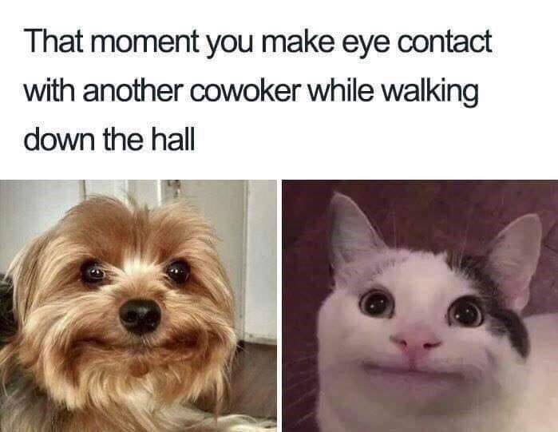
Eye Contact
Maintain eye contact during conversations to show interest and respect

Slide 12
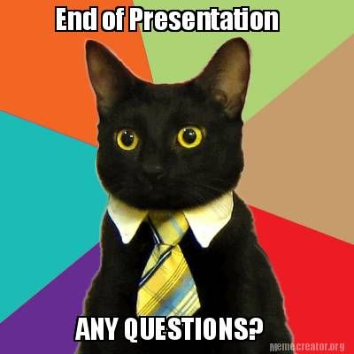
The end

